Slide 1
Online Examination Monitoring Platform
North South University
CSE499B.6 Summer 2020
Supervisor:
Mohammad Ashrafuzzaman Khan (AzK)
Presented by:
Md Sharif Hossain
Kazi Moshiur Rahman
Rubaida Ferdous
Galib Faruk Gani

Slide 2
Problem Analysis
PROBLEM
SOLUTION
Online Examination Monitoring problem
Identity lacking
Forbidden resource using
Answers leaking or sharing while conducting exams
Online Examination Monitoring Platform
Identity Confirmation Biometrically using Face Recognition
Browser tab switching or minimization monitoring
Freezing clipboard to copy-paste the questions.

Slide 3
Related Works
Video conferencing or form sharing platforms
Canvas Learning Management System
01
02
Google Meet, Zoom, Microsoft Teams, Skype, Google form, Google doc, etc.
Not too strict or well proctored
Proctoring software, lockdown browsers, and plagiarism scanners
Too costly

Slide 4
Works Done over the course
Registration & Login
01
Face Verification
04
Course Management
45%
02
05
Examination Module
Video Conferencing
03
06
Integration

Slide 5
Collaboration and Contribution
GitHub:
For collaborating works among groupmates
Tasks | Responsibilities
Problem & solution analysis | SH, KR, RF, GG
Functional analysis | SH, KR, RF, GG
Video Conference | SH, KR
Registration module | SH, KR
Dashboard & course management | SH, KR, RF
Face verification | SH, KR
Examination module | SH, KR
Integration | SH, KR, RF, GG
Report & presentation | SH, KR, RF, GG

Slide 6
Most Unique Part
Identity verification biometrically
Face Verification
Clipboard and keyboard freezing during MCQ exams
Online Examination Monitoring
Cannot copy-paste the questions
Separate written examination system
Need to write in browser tab
Activities monitoring
Page-Visibility-API, Monitoring browser tabs switching

Slide 7






Used Tools
React
DNN
Video Conferencing
Face Recognition
Frappe
OpenCV
Integration
ERPNext, Python, JavaScript
Face Recognition
Visual Studio Code
GitHub
Code editor
Collaboration

Slide 8
Design of the Project
01
02
03
04
05
06
Problem & Solution analysis
Video Conference
Face Recognition
Registration & Dashboard
Examination Module
Integration
What to do and How to do?
Using JavaScript in React
Python & JS in DNN & OpenCV
JS, HTML
JavaScript & HTML
Python, JS in Frappe
Beginning
End

Slide 9
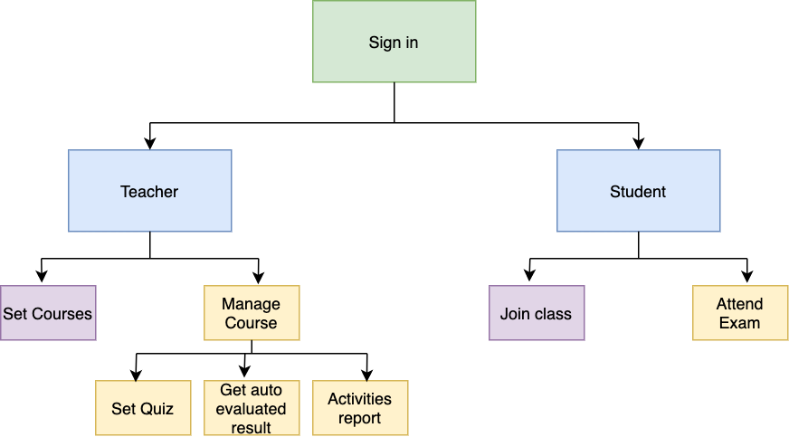
User Flow of the Project

Slide 10
Result Analysis
95%
Video conference, registration module
CSS issues
85%
Dashboard and Course module
CSS issues, not perfectly oriented
Face Verification
80%
Works independently, problems did arise in training data while integrating
Examination module
80%
Works independently, quiz is fine, lacking in written part
70%
Integration
Faced complexities while working with multi platform

Slide 11
Thanks to all!

